Slide 1
CS4038
DATA MINING
LECTURE # 06
SPRING 2024
FAST – NUCES, CFD CAMPUS
AYESHA LIAQAT
ayesha.liaqat@nu.edu.pk

Slide 2
TODAY’S TOPICS
Data Preprocessing
Data redundancy
Chi-square: quick recap
Correlation analysis

Slide 3
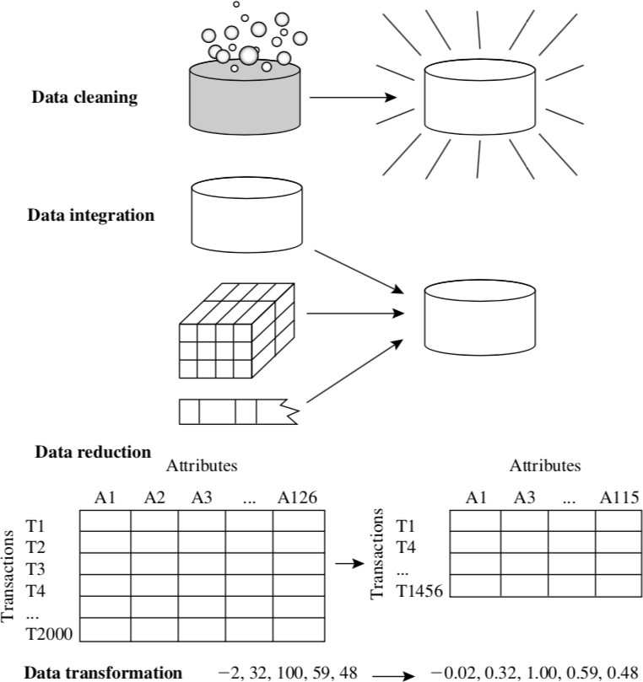
FORMS OF DATA PREPROCESSING

Slide 4
DATA PREPROCESSING
DATA INTEGRATION

Slide 5
DETECTING REDUNDANT DATA
Redundant data may be able to be detected by correlational analysis
Followings are the correlational analysis methods.
1.
X² test
(for nominal, categorical or discrete data)
Basic idea: The X² checks the hypothesis that two attributes, A and B, are independent. If this hypothesis can be rejected, we can say that A and B are statistically correlated and one of them (either A or B) can be discarded.
2. Correlation coefficient and covariance analysis (for numeric or quantitative data)

Slide 6
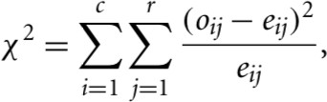

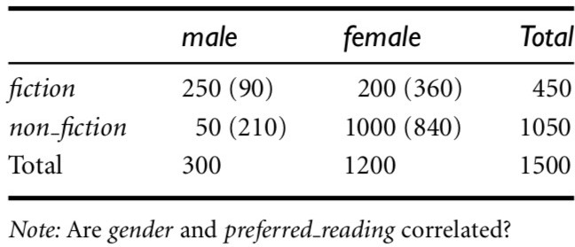
CHI-SQUARE CORRELATION TEST FOR NOMINAL DATA
For two nominal attributes, A and B, correlation can be determined using X² (chi- square) test.
A contingency table is constructed with values of A and B such that (A_{i}, B_{j}) denote the joint event that attribute A takes on value a_{i} and attribute B takes on value b_{j}.
The X² value is computed as:
o_{ij} is the observed frequency (or actual count) of the joint event (A_{i}, B_{j}) and e_{ij} is the expected frequency of (A_{i}, B_{j})

Slide 7
CHI-SQUARE CORRELATION TEST FOR NOMINAL DATA
To perform X² test:
Formulate hypothesis
Create contingency table of (collected) data
Calculate X² value
Test the hypothesis; null hypothesis rejected or not.

Slide 8
EXAMPLE: CHI-SQUARE CORRELATION TEST
Step 1: Formulate hypotheses
For Hypothesis testing, first we need to formulate our null (H₀) and alternative (H_{a}) hypotheses:
H₀: Gender and reading preference variables are independent
H_{a}: Gender and reading preference variables are dependent
Null hypothesis is assumed to be true until we have evidence to reject it.
Chi-square correlation test is also known as Chi-square test of independence.

Slide 9
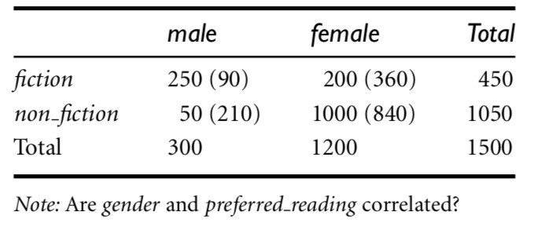
EXAMPLE: CHI-SQUARE CORRELATION TEST
Step 2: Create contingency table
Example 3.1 (from book by Han)
1500 people surveyed about their preferred type of reading material.
Gender is also recorded with their responses.
The chi-square test will determine if the difference in reading preferences based on gender is occurring by chance or the difference is statistically significant.

Slide 10

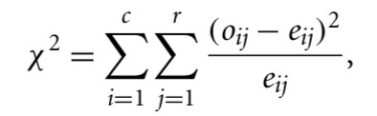
EXAMPLE: CHI-SQUARE CORRELATION TEST
Step 3: Calculate Chi-square test statistic
Example 3.1 (from book by Han)
1500 people surveyed about their preferred type of reading material.
Gender is also recorded with their responses.
Compute the chi-square value using X²
formula.
Compute the remaining expected values.

Slide 11
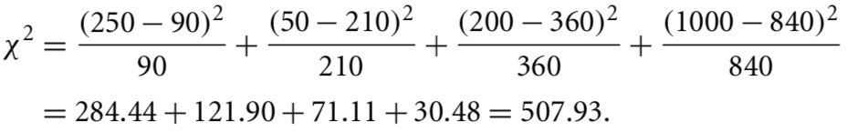
EXAMPLE: CHI-SQUARE CORRELATION TEST
Step 3: Calculate Chi-square test statistic
Example 3.1 (from book by Han)
1500 people surveyed about their preferred type of reading material.
Gender is also recorded with their responses.
Compute the chi-square value using X²
formula.
The chi-square test statistics is
507.93.

Slide 12
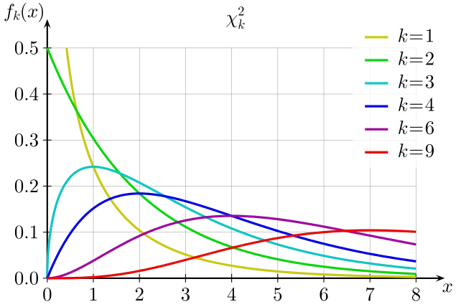
CHI-SQUARE DISTRIBUTION
k: degrees of freedom

Slide 13
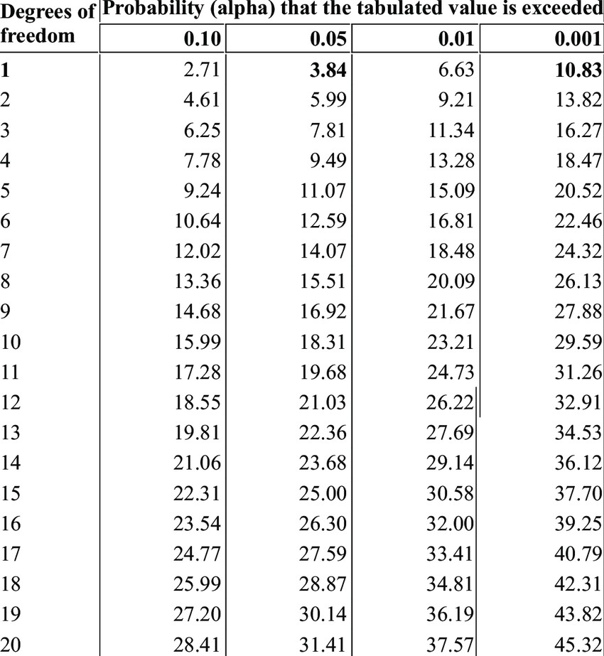
CHI-SQUARE TABLE
Look into the chi-square distribution table with 𝛼 and DF to find chi-square critical value X²
𝛼

Slide 14
EXAMPLE: CHI-SQUARE CORRELATION TEST
Under the null hypothesis, the chi-square test statistic follows a chi-square distribution with degrees of freedom equal to (r-1)(c-1)
r = no. of rows; c = no. of columns
To find the chi-square critical value X² we need a significance level (𝛼). Usually, a
𝛼
confidence level of 95% (or c=0.95) is used, so the 𝛼 = 1-c = 1-0.95=0.05.
Look into the chi-square distribution table with 𝛼 and DF to find chi-square critical value X²
𝛼
Reject the null hypothesis if chi-square test statistic > chi-square critical value otherwise we fail to reject the null hypothesis
In our example: 𝛼=0.05 and DF = (2-1)(2-1)=1
Chi-square critical value = 3.84
our chi-square test statistic is greater than the X² critical value (i.e., 507.93 > 3.841).
15
So, we reject the Null hypothesis.
𝛼

Slide 15
DETECTING REDUNDANT DATA
Redundant data may be able to be detected by correlational analysis
Followings are the correlational analysis methods.
X² test (for nominal, categorical or discrete data)
Basic idea: The X² checks the hypothesis that two attributes, A and B, are independent. If this hypothesis can be rejected, we can say that A and B are statistically correlated and one of them (either A or B) can be discarded.
2.
Correlation coefficient
and (for numeric or quantitative
covariance analysis
data)

Slide 16
CORRELATION ANALYSIS (NUMERIC DATA)
The measure of linear relationship between two data objects that have binary or continuous variables.
Covariance and Correlation coefficient (also called Pearson’s product moment coefficient) can be used for this purpose.
Covariance: measures how the two variables differ
Correlation: measures how the two variable are related

Slide 17




COVARIANCE (NUMERIC DATA)
Covariance is a measure to determine how two attributes change together, similar to correlation.
Consider two numeric attributes, A and B, and a set of n observations
{(a₁,b₁),…,(a_{n},b_{n})}.
Mean values of A and B (known as expected values) are computed as:
Covariance between A and B is defined as:
Or alternatively:
Use n for population in the denominator and
19
use n-1 for sample.

Slide 18
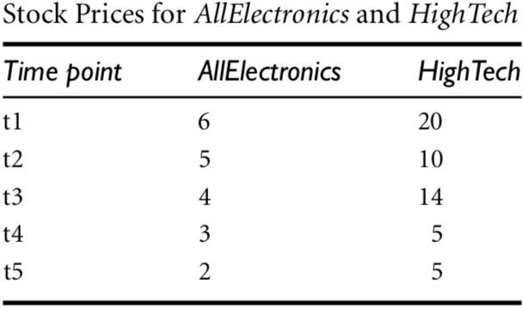
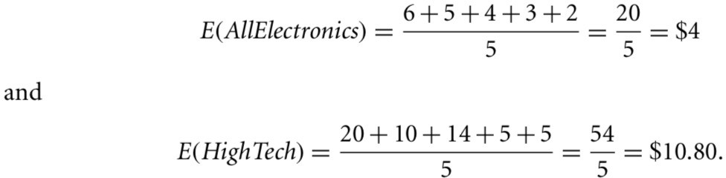
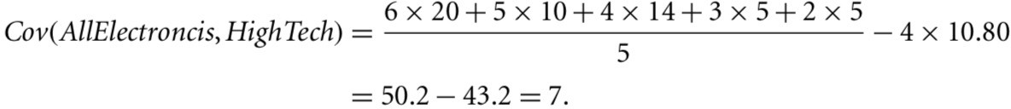
EXAMPLE: COVARIANCE
If the stock prices are affected by the same industry trends, will their prices rise or fall together?
Example 3.2 (from book by Han)
Given the positive covariance, we can say that stock prices for both companies rise together.
20

Slide 19
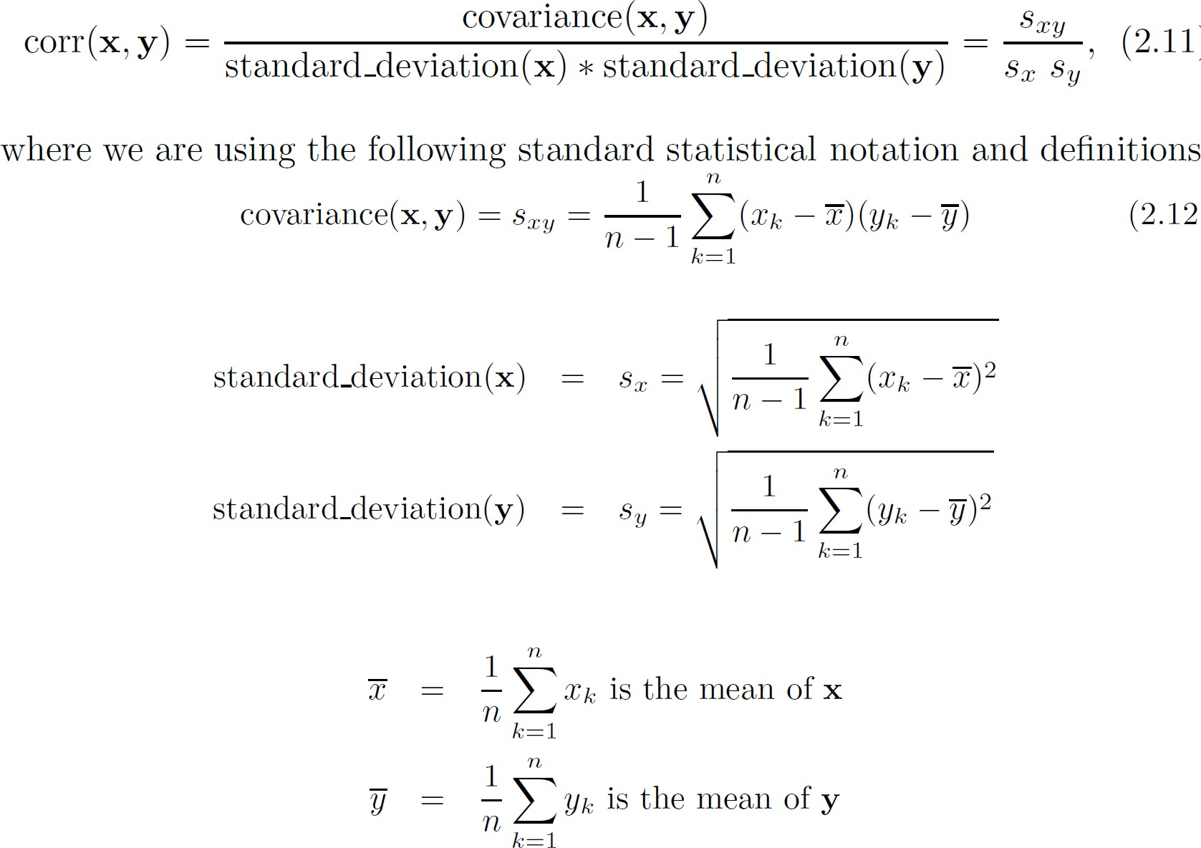
PEARSON’S CORRELATION
Correlation is always in the rage of -1 to 1 (representing perfect negative and positive linear relationship).
FALL 2022
21

Slide 20
CORRELATION (VIEWED AS LINEAR RELATIONSHIP)
Correlation measures the linear relationship between objects
To compute correlation, we standardize data objects, A and B, and then take their dot product
a'_{k} = (a_{k} − mean( A)) / std ( A)
b'_{k} = (b_{k} − mean(B)) / std (B)
correlation( A, B) = A'•B'

Slide 21
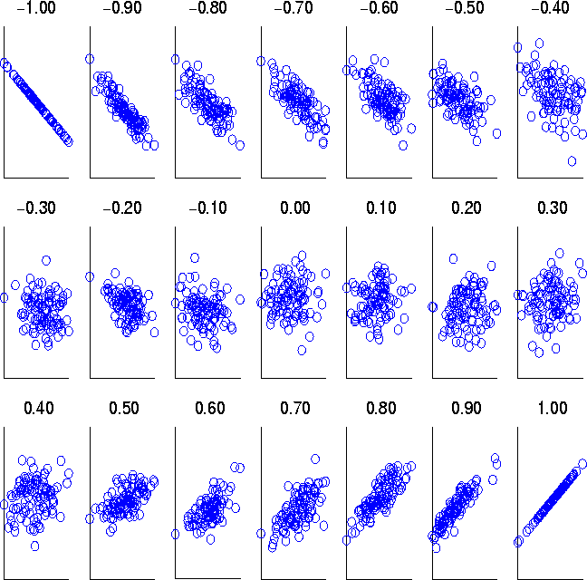
VISUALLY EVALUATING CORRELATION
If corr(x,y) > 0, x and y are positively correlated (i.e., x’s values increase as y’s). The higher, the stronger correlation.
corr(x,y) = 0: both are independent corr(x,y) < 0: negatively correlated
Scatter plots showing the similarity from –1 to 1.

Slide 22
CORRELATION DOES NOT IMPLY
CAUSALITY!!!

Slide 23
READING MATERIAL
Chapter 2:Tan, Steinbach & Kumar
Chapter 3: Han, Kamber & Pei
Articles on Chi-Square Test:
https://online.stat.psu.edu/stat500/lesson/8/8.1
https://www.ncbi.nlm.nih.gov/pmc/articles/PMC3900058/
https://sphweb.bumc.bu.edu/otlt/MPH-Modules/BS/BS704_HypothesisTesting- ChiSquare/BS704_HypothesisTesting-ChiSquare3.html
An article on Data Cleaning: https://elitedatascience.com/data-cleaning

